Slide 1
CoderSii, 3.10.2018,
Getting started with microservices
Docker & Kubernetes

Slide 2


introduction of presenter
↓ | Paweł Ruciński
 | Software Developer, Gdańsk, CC Digital Backend developer focused on a cloud based architecture Working for Sii since May, prucinski@pl.sii.eu, pawel.rucinski90@gmail.com
PAWEŁ FROM SII GDAŃSK

Slide 3

What are microservices?
Microservices - also known as the microservice architecture - is an architectural style that structures an application as a collection of loosely coupled services, which implement business capabilities. The microservice architecture enables the continuous delivery/deployment of large, complex applications. It also enables an organization to evolve its technology stack.
Source: microservices.io
Notes:
3

Slide 4
Presentation objectives
Docker,
Kubernetes,
Azure
Notes:
4

Slide 5
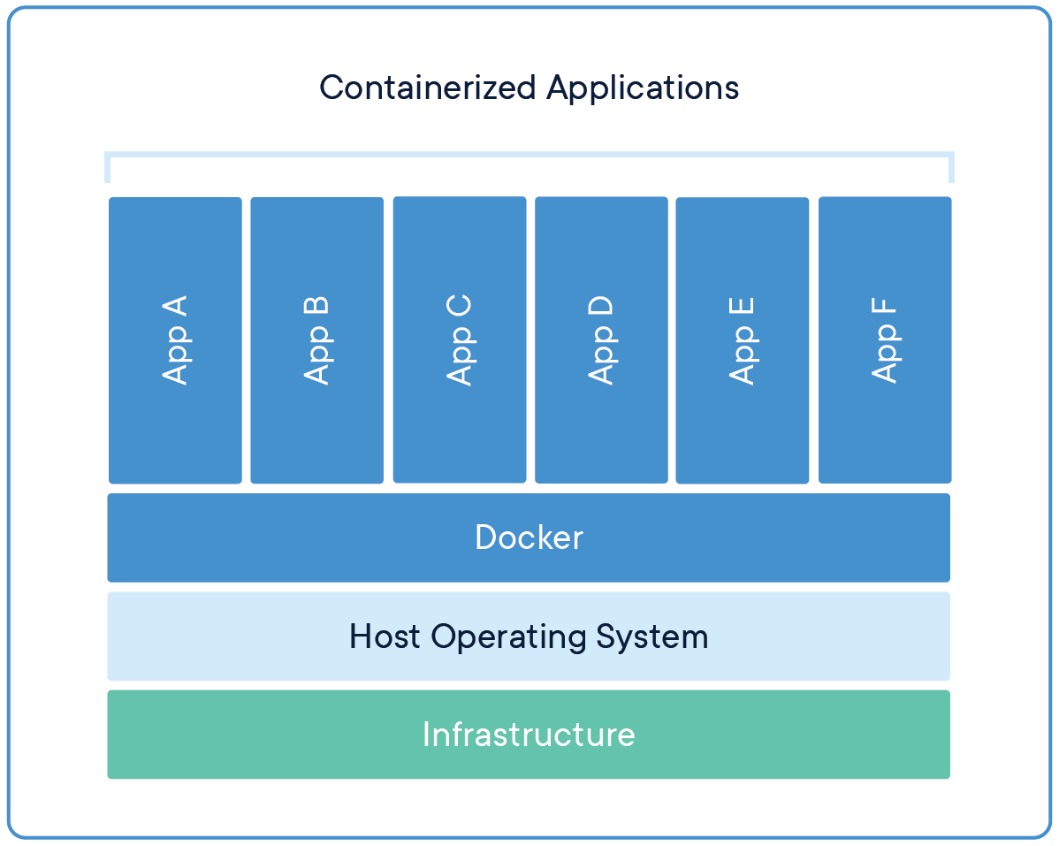
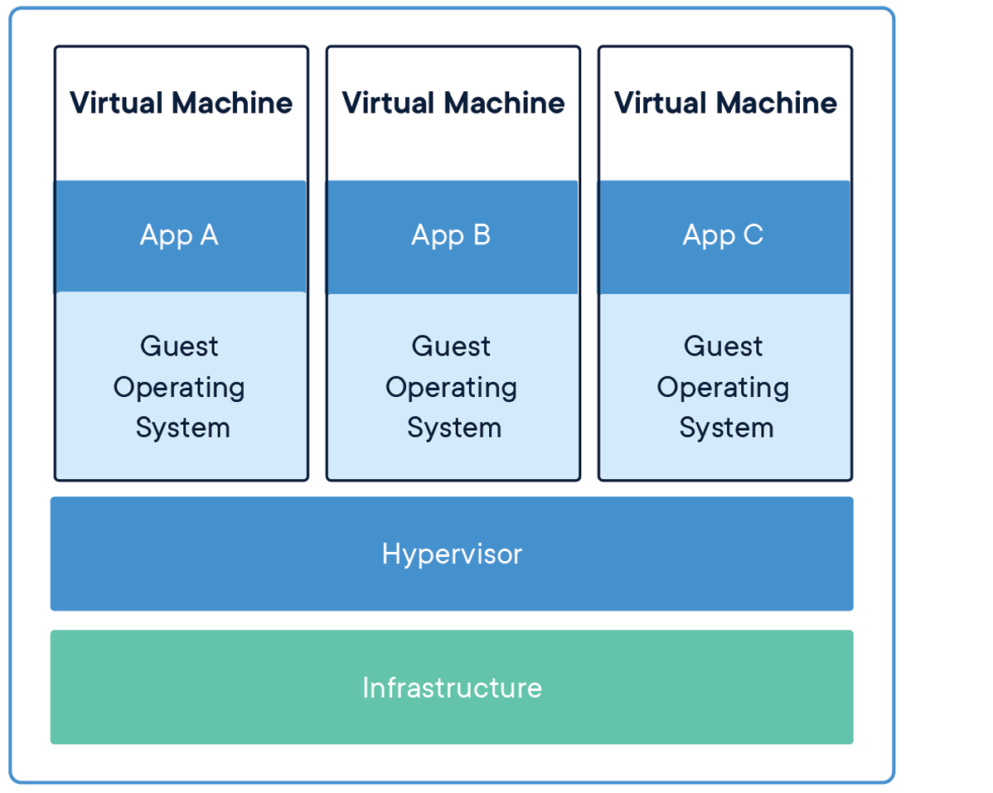
Docker
Docker is a computer program that performs operating-system-level virtualization, also known as "containerization".
Source: Wikipedia.org
Source: Docker.com
Notes:
5

Slide 6
Main docker objects
Image
Container
Registry
Notes:
6

Slide 7

Docker Presentation

Slide 8
Kubernetes
Kubernetes is a portable, extensible open-source platform for managing containerized workloads and services, that facilitates both declarative configuration and automation. Source: kubernetes.io
Notes:
8

Slide 9
Kubernetes
Pod
Controllers:
ReplicationController
Deployments
StatefulSets
…
Services
…
Notes:
9

Slide 10
Kubernetes Presentation

Slide 11
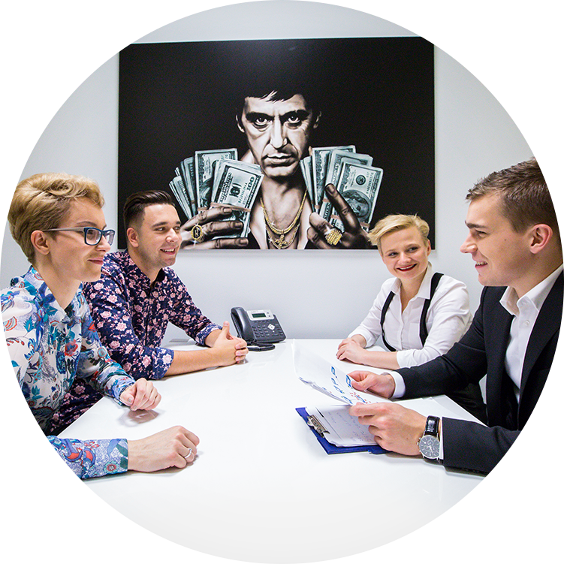
Time to take it on your own
Helpful links:
https://docs.docker.com/get-started/
https://docs.microsoft.com/en-us/azure/container-instances/
https://docs.microsoft.com/en-us/azure/container-registry/
https://kubernetes.io/docs/user-journeys/users/application-developer/foundational/
https://docs.microsoft.com/en-us/azure/aks/

Slide 12
Keep in touch
Presentation resources:
https://github.com/meanin/getting-started-with-microservices/
Linked.in:
https://www.linkedin.com/in/meanin/
Contact:
prucinski@pl.sii.eu
pawel.rucinski90@gmail.com

Slide 13


